Slide 1

Recommendation System for Venture Capital Investors
Group 4
Akshata Deo (012565761)
Keerthy Akella (013858819)
Nivetha Jayakumar (013758667)
Sibirajan Sadhasivam (013785369)
Uma Nataraj (013727259)

Slide 2
Motivation
Venture Capitalists based investment are rising
More than 10 million startups are founded in USA each year
As the startup funding atmosphere is reaching a mature state, it is important for venture capitalist and fund manager to prioritize their investments to gain highest returns in a bearable risk level
This project aims at providing analytical guidance by using recommender system for the VCs in choosing right investment target based on effective parameters

Slide 3
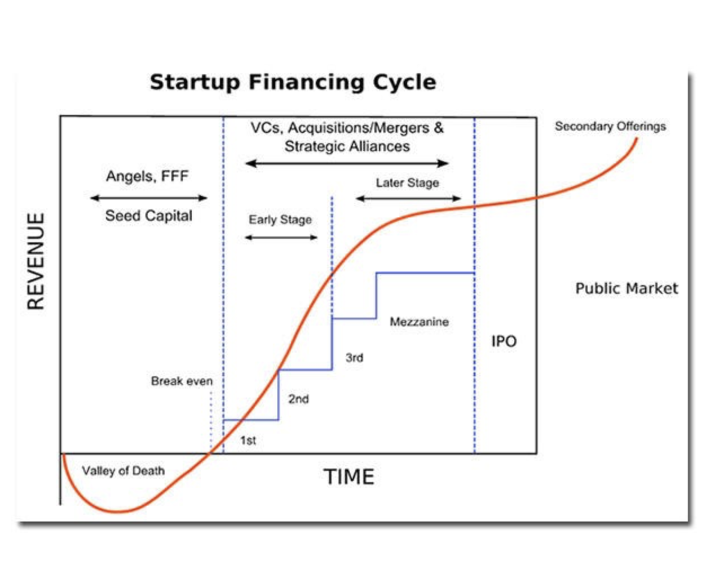
What is VCs Investments ?
Source - https://medium.com/investing-in-africa/startup-financing-cycle-5754b80cbc84

Slide 4
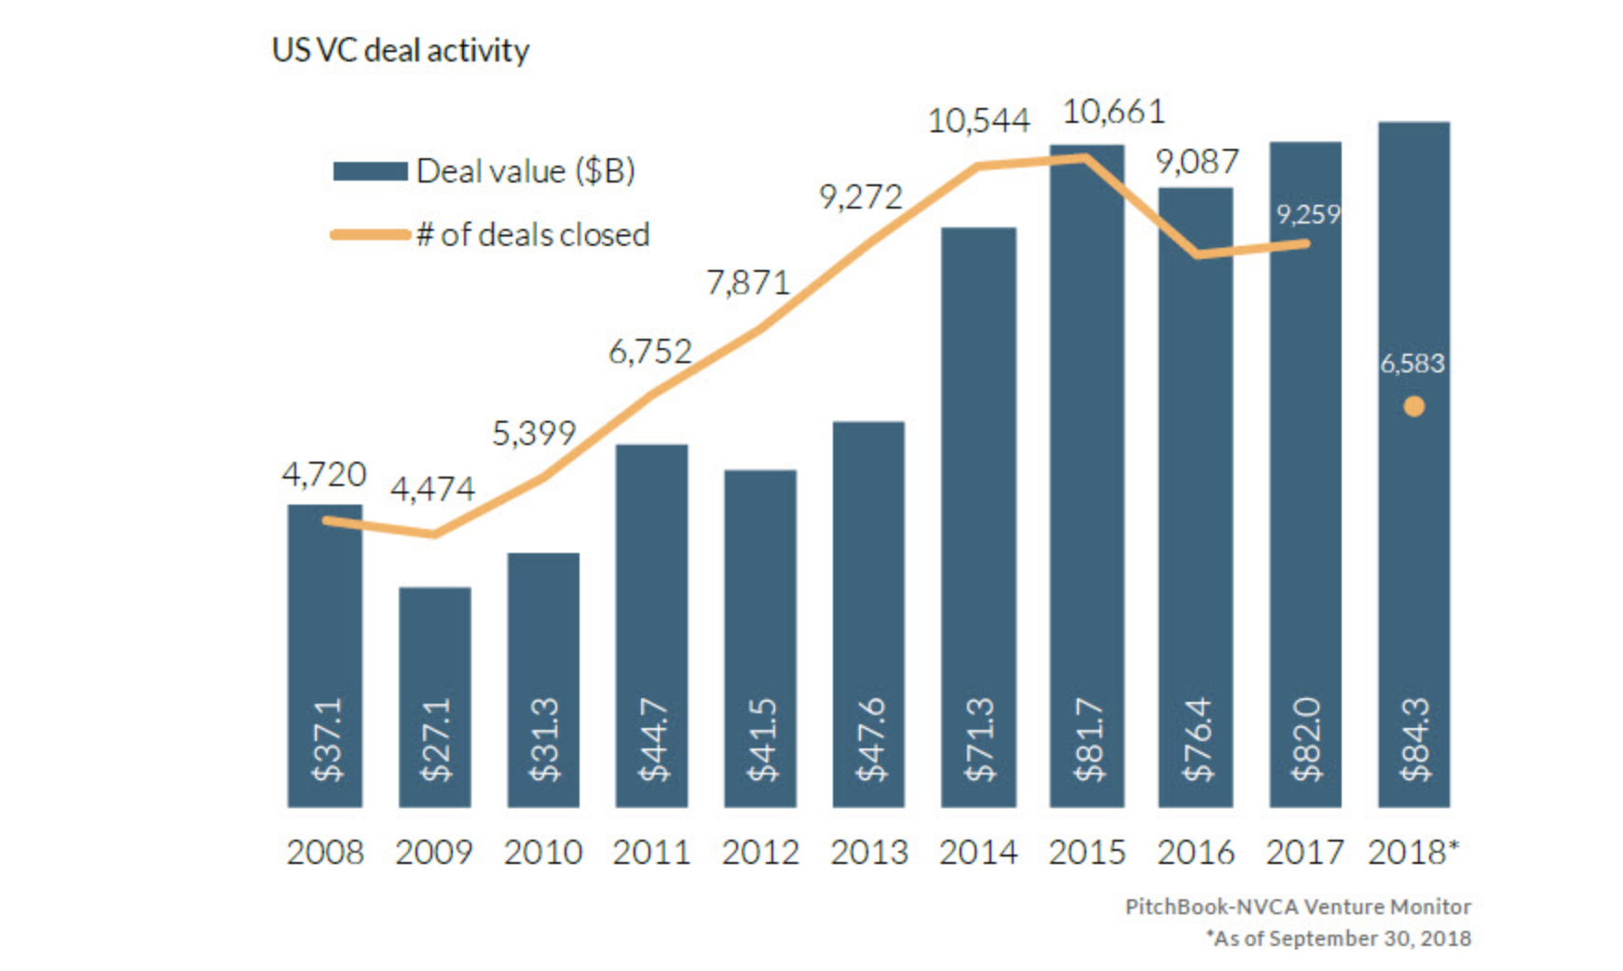
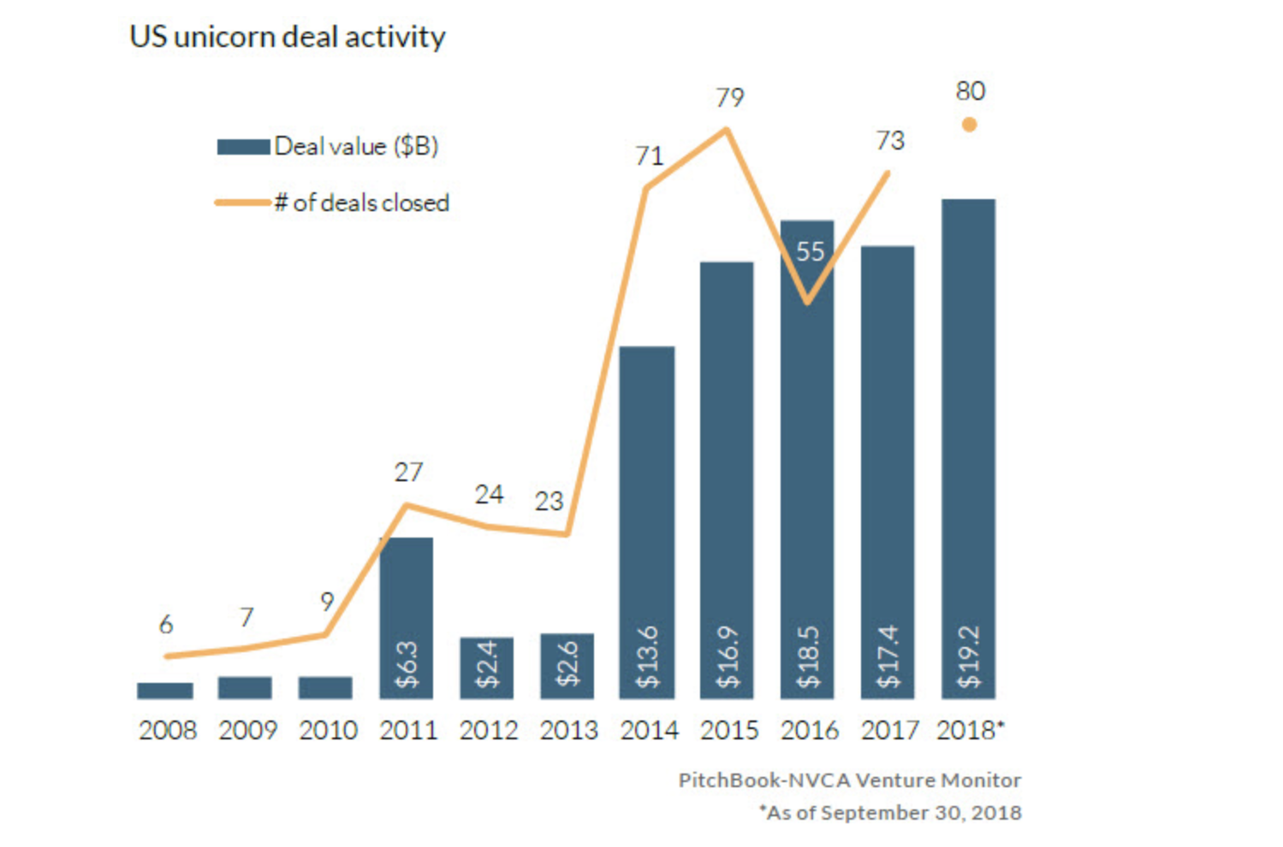
The amount of VC invested in the US is on pace to top $100 billion this year and set a record.
One reason for the record amount of venture capital invested this year is the rise of unicorns. As of the end of the quarter, companies with valuations of $1 billion or more had closed 39 transactions for a total of $7.96 billion. That's on pace for a new high in terms of both deal value and count.
Source - https://pitchbook.com/news/articles/the-state-of-us-venture-capital-activity-in-15-charts

Slide 5
Factors Considered To Approach This Problem
Management
VCs are looking ideally for executives who have successfully built businesses that have generated high returns for the investors.
Size of the Market
VCs generally want to ensure that their portfolio companies have a chance of growing sales worth hundreds of millions of dollars.
Great Product with Competitive Edge
VCs look for a solution to a real, burning problem that hasn't been solved before by other companies in the marketplace.

Slide 6
Factors Considered To Approach This Problem(Contd.)
Assessment of Risks
A VC's job is to take on risk. VCs will want to be absolutely clear about what the business has accomplished and what still needs to be accomplished.
Recommendation techniques have the possibility of helping VCs making data-driven investment decisions by providing an automatic screening process of a large number of startups across different domains on the basis of their past investment data.
The above factors, with the help of machine learning techniques have the potential to revolutionise the flourishing market phenomenon.

Slide 7
Dataset Overview
Mattermark (https://mattermark.com/) | Info on Companies ,Investors and 5,000+ investment events REST API protocol used to obtain datasets Python request library used to obtain data from Mattermark API. More data available only on paid subscription
Crunchbase (https://www.crunchbase.com/) | 12,000 companies, 11,000 investors and 52,000+ investment events info available API access restricted since 2016. Last available data in mass quantity - 2013 Snapshot, officially provided by the company

Slide 8
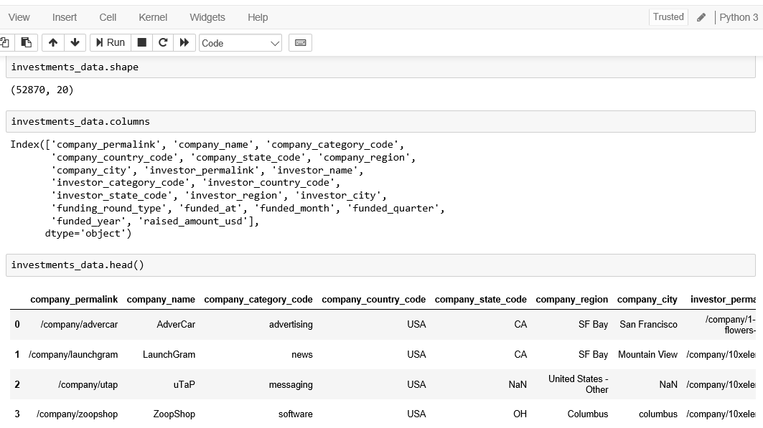
Snapshot of raw data from Crunchbase

Slide 9
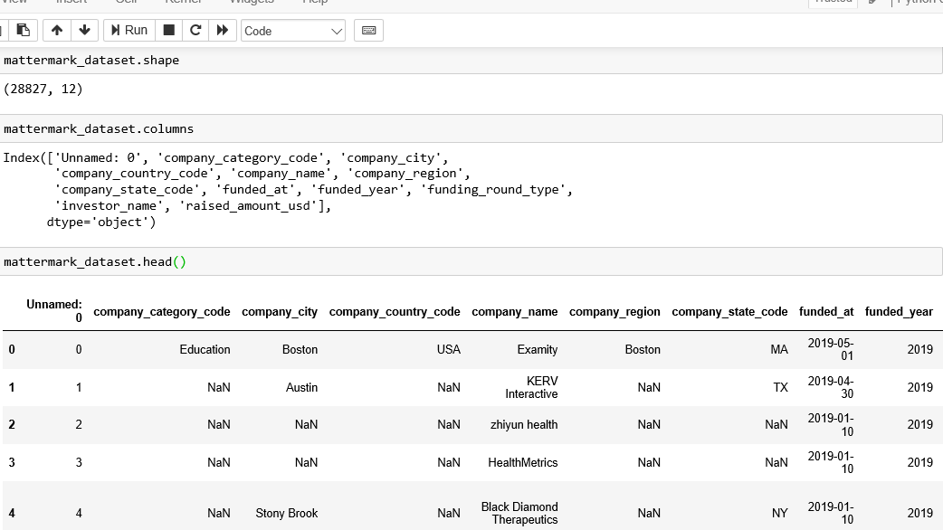
Snapshot of raw data from Mattermark

Slide 10
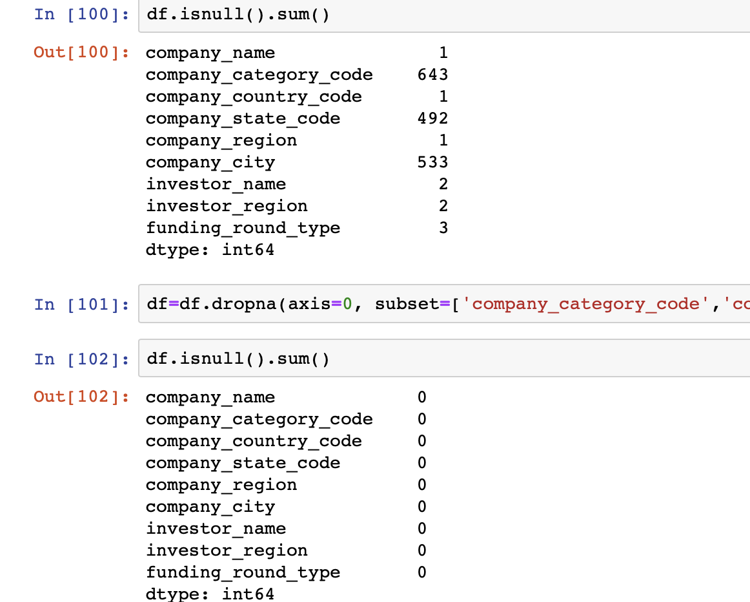
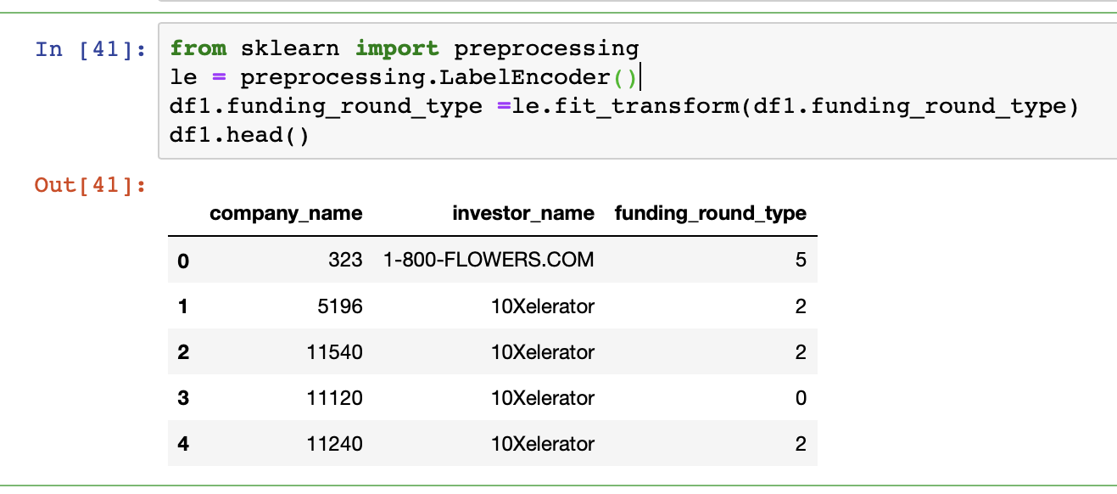
Data preprocessing
Combined two datasets
Data Cleaning:
Feature selection (Drop/add attributes)
Handling missing /duplicate values
Normalising/Making the data even looking
Instances Selection and Partitioning:
4:1 training and testing dataset
Representation Transformation:
Label Encoding(for categorical values)

Slide 11
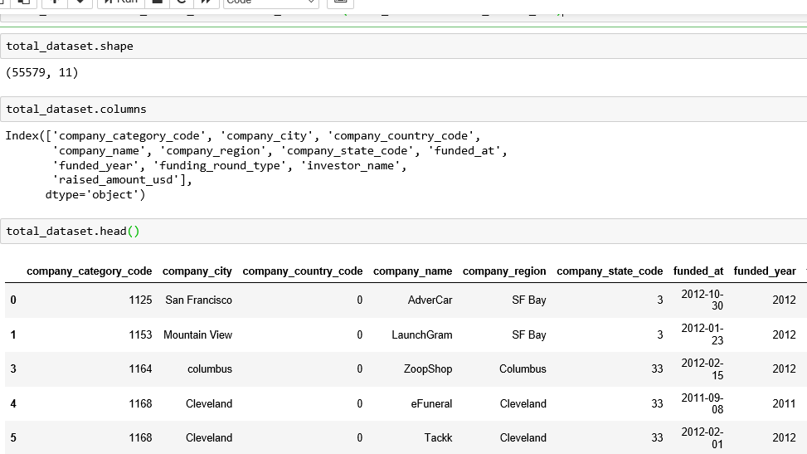
Snapshot of refined dataset

Slide 12
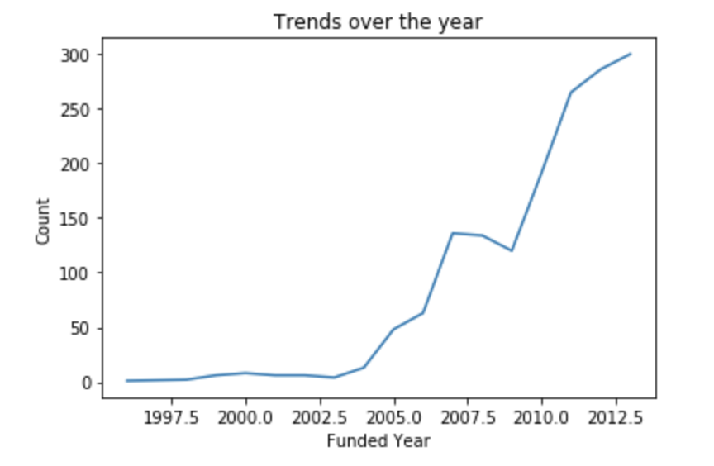
Data Visualization

Slide 13
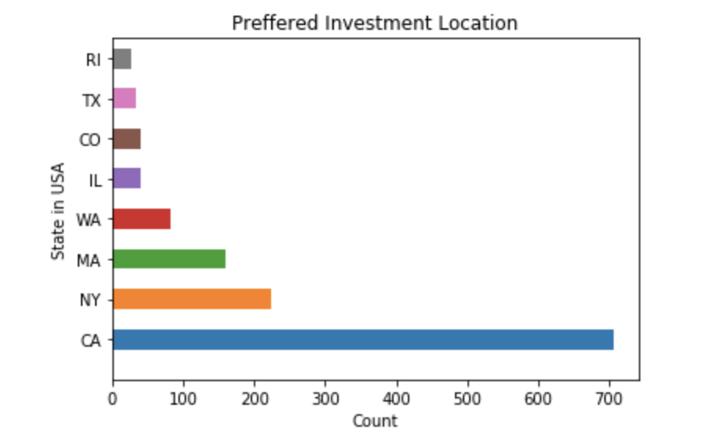
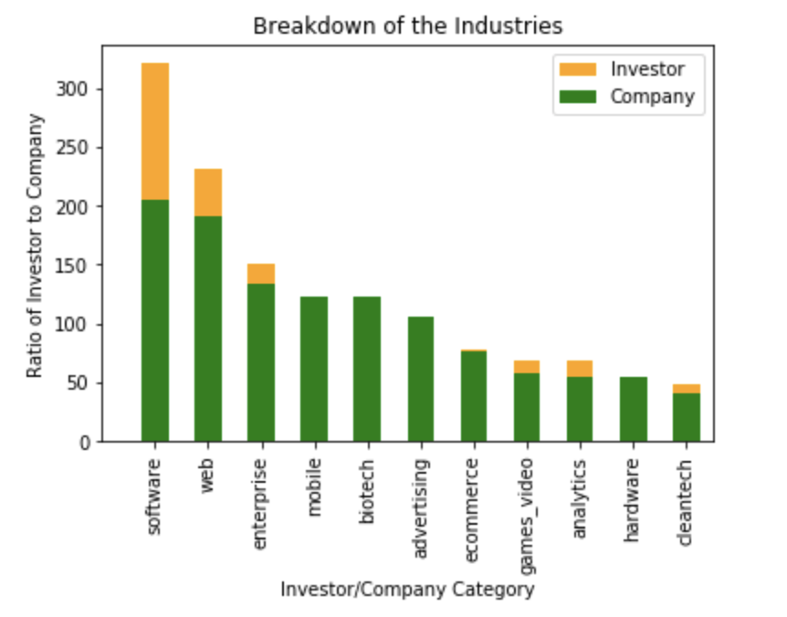
Data Visualization

Slide 14
Recommendation Models
For this project we have used following three recommendation models:
Content based
User based collaborative filtering
K nearest neighbour

Slide 15
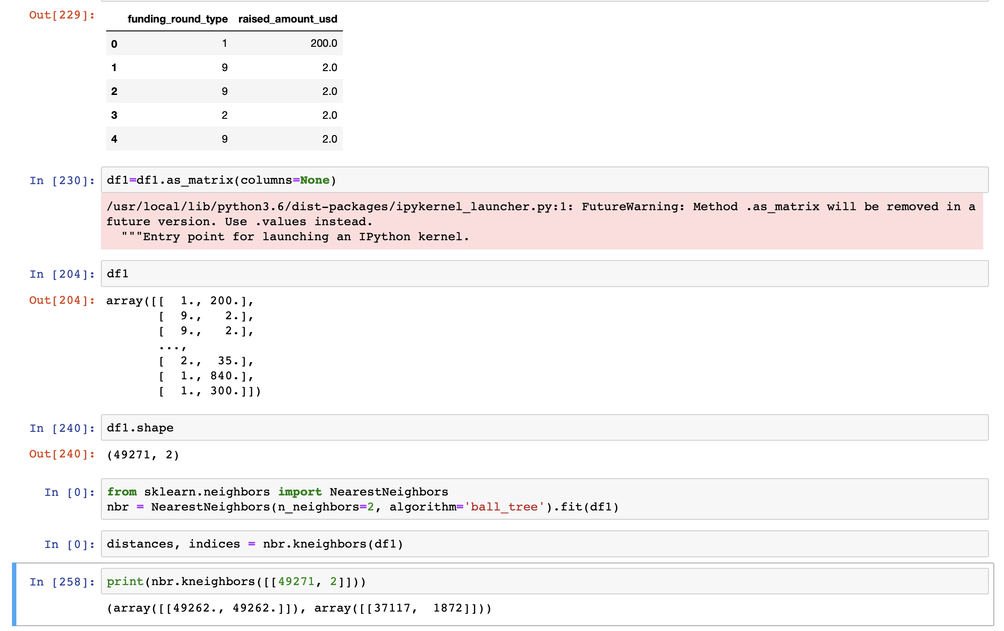
Recommender model analysis
K- Nearest Neighbor algorithm --
Chose to keep the input data in 2D
After data preparation, converted the dataframe into NumPY array,each element representing the rows of the dataframe
Model was trained and output was observed
Inferences --
Short of attributes with numerical values
Most of the attributes have multiple classes, making it tedious for the algorithm , indirectly affects recommendation.

Slide 16
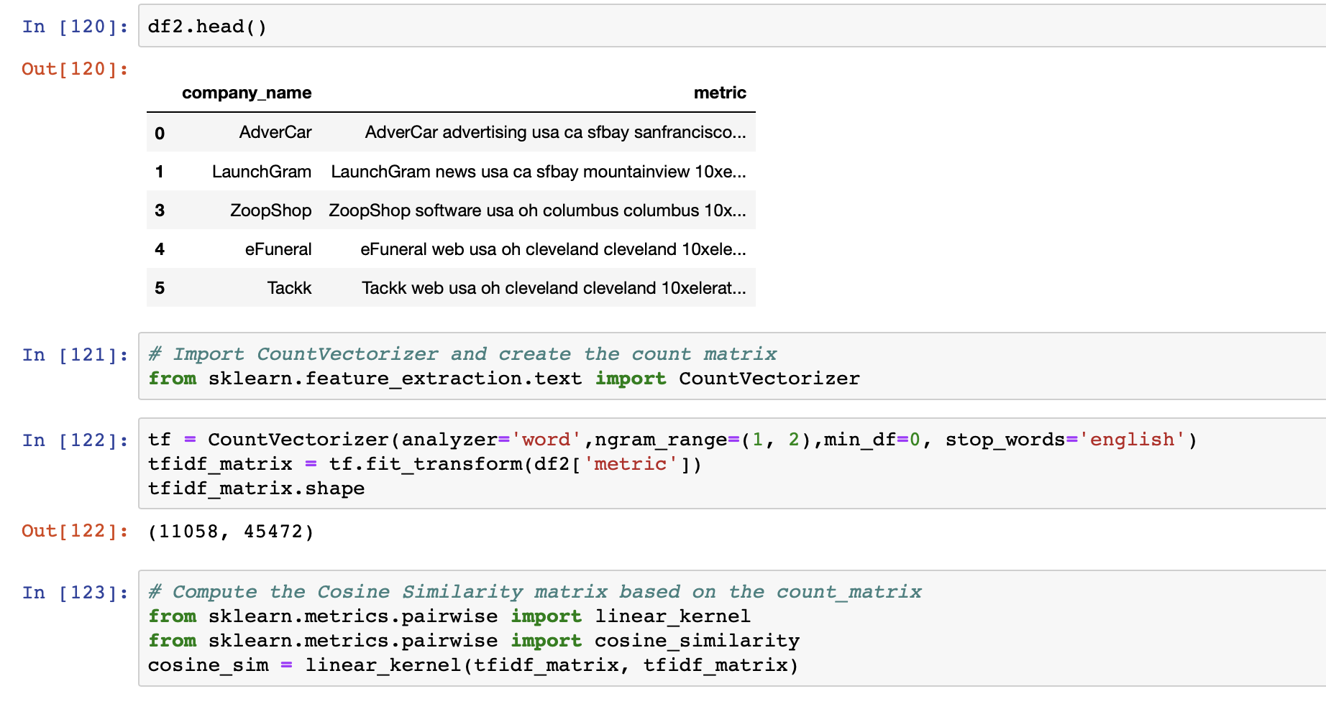
Recommender model analysis
Content based filtering
Multiple attributes/columns of the processed data were used.
A metric column was created by combining the columns after Data cleaning, preprocessing and normalizing
Word embedding methods were tested, to convert english into meaningful numbers
Matrix was created which was used to create the similarity matrix

Slide 17
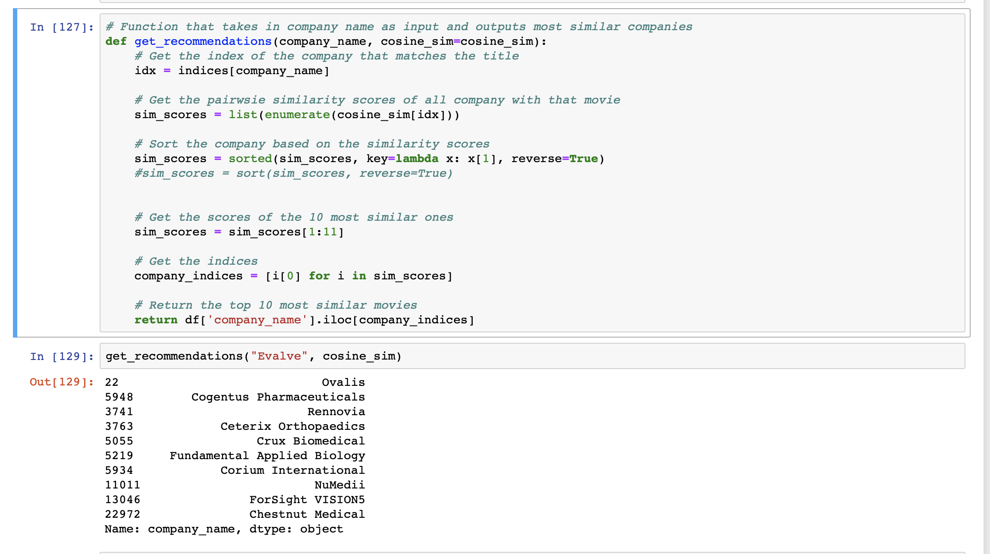
Content based filtering (contd.)
Inferences --
Recommendation were partially biased for different word embedding technique and similarity measure used.
Model evaluation to be done so as to analyze model efficiency and to stick to one with better accuracy

Slide 18
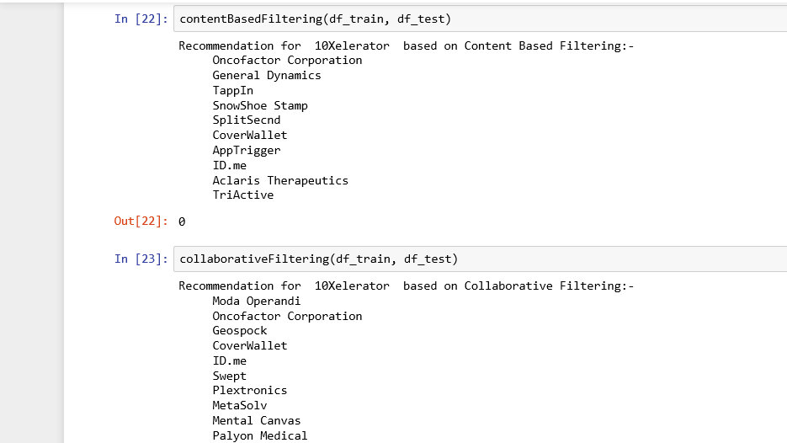
CB & CF recommendation model results

Slide 19
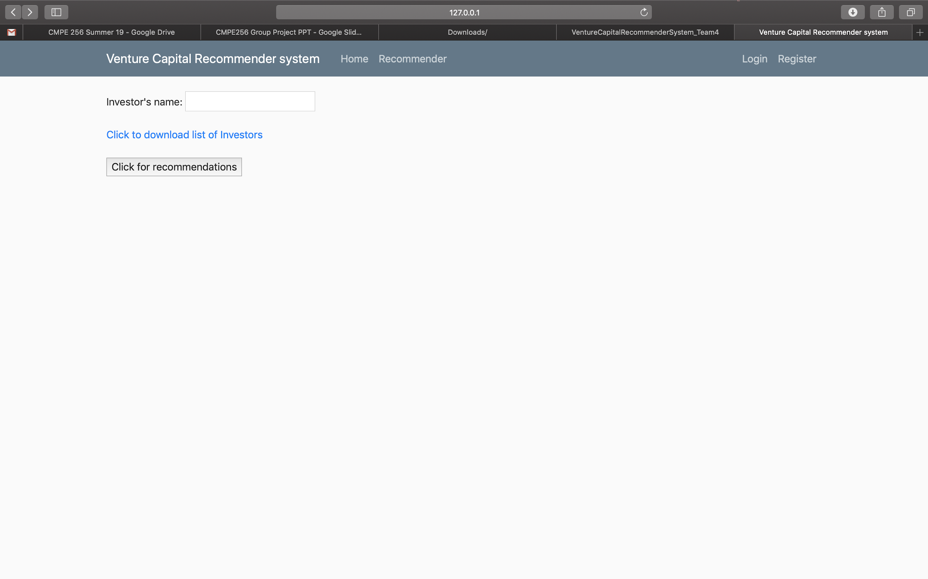
Web UI screenshot

Slide 20
Problems faced during the Project
Comparing the sparsity directly to other datasets, such as MovieLens1M and Netflix, our dataset was extremely sparse (over 99.9%) and long-tailed
Shortage of numerical data makes it hard to find relation with words(which are not as relating as numerical data)
The investment behaviours are much sparser than conventional recommendation applications and a VC's investments are usually limited to a few industry categories, making it impossible to use a topic-diversification method to hedge the risk.

Slide 21
Future work on this project could be
Risk factors should be cautiously considered when making investments: for a potential startup, a VC needs to specifically estimate how well this new investment can fit into its holding investment portfolio in such a way that investment risk can be hedged
Ranking algorithm can be used for diverse recommendation
“crowdfunding” which generally operate through online platforms (e.g., AngelList). This approach is a different ball game and provide additional impetus and scope for applying information retrieval techniques to this domain.

Slide 22

Thank you for your attention.
Any questions?

Slide 23
References
[1] https://www.quora.com/How-many-tech-startups-are-created-worldwide-each-year
[2] Source - https://medium.com/investing-in-africa/startup-financing-cycle-5754b80cbc84

